Slide 1


2019 JCI Malaysia
Membership Lifecycle Strategy
Workshop

Slide 2


OBJECTIVES
To understand the strategies for sustainable membership development within an organization
To discuss about the tools to be used
To brainstorm effective strategies to address the challenges within the membership lifecycle
HOW IS JCI DIFFERENT FROM OTHER ORGANIZATIONS?

Slide 3
OBJECTIVES
To understand the strategies for sustainable membership development within an organization
To discuss about the tools to be used
To brainstorm effective strategies to address the challenges within the membership lifecycle
HOW IS JCI DIFFERENT FROM OTHER ORGANIZATIONS?

Slide 4


To develop oral communication skills and leadership skills, which in turn foster self-confidence and personal growth.
Notes:
JCI members take initiative to solve local challenges. More than a one-time donation or service opportunity, we focus on sustainable impact locally and globally. It only takes one active citizen to change the world. Be that active citizen today.

Slide 5


To empower volunteers to serve their communities, meet humanitarian needs, encourage peace and promote international understanding through Lions clubs.
Notes:
JCI members take initiative to solve local challenges. More than a one-time donation or service opportunity, we focus on sustainable impact locally and globally. It only takes one active citizen to change the world. Be that active citizen today.

Slide 6


To bring together business and professional leaders in order to provide humanitarian service and to advance goodwill and peace around the world.
Notes:
JCI members take initiative to solve local challenges. More than a one-time donation or service opportunity, we focus on sustainable impact locally and globally. It only takes one active citizen to change the world. Be that active citizen today.

Slide 7


To help members increase their business through a structured, positive, and professional referral marketing program that enables them to develop long-term, meaningful relationships with quality business professionals.
Notes:
JCI members take initiative to solve local challenges. More than a one-time donation or service opportunity, we focus on sustainable impact locally and globally. It only takes one active citizen to change the world. Be that active citizen today.

Slide 8


To provide development opportunity that empowers young people to create positive change.
Notes:
JCI members take initiative to solve local challenges. More than a one-time donation or service opportunity, we focus on sustainable impact locally and globally. It only takes one active citizen to change the world. Be that active citizen today.

Slide 9

Notes:
Junior Chamber International is a non-profit international non-governmental organization[1] of young people between 18 and 40 years old. It has members in about 124 countries, and regional or national organizations in most of them.[citation needed] It was founded in Mexico in 1944, and has consultative status with the Council of Europe, with the Economic and Social Council of the United Nations and with UNESCO. It encourages young people to become active citizens and to participate in efforts towards social and economic development, and international cooperation, good-will and understanding.
It publishes JCI World, a quarterly magazine, in six languages.[1] It holds an annual conference, the JCI World Congress, in November of each year, and regional annual meetings, the JCI Area Conferences. Some members are given life membership of the organization and become "senators".

Slide 10
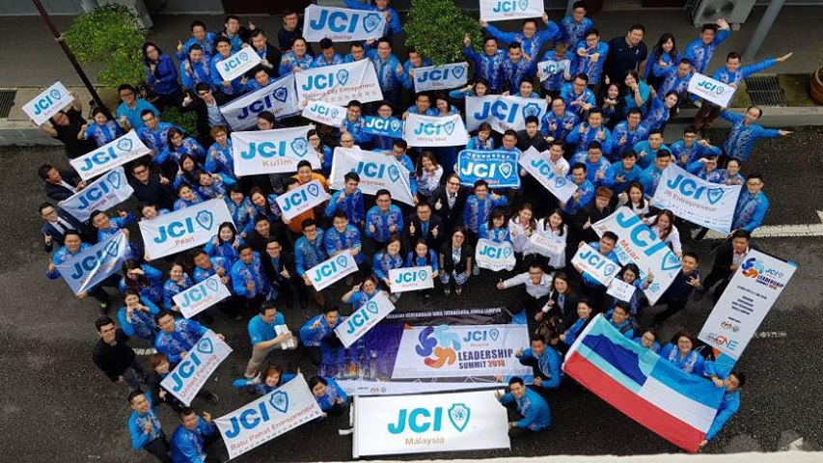
Reintroducing Junior Chamber International
Notes:
JCI is a nonprofit organization of young active citizens age 18 to 40 who are engaged and committed to creating impact in their communities. Active citizens are individuals invested in the future of our world. JCI gathers active citizens from all sectors of society. We develop the skills, knowledge and understanding to make informed decisions and take action.

Slide 11
THE JCI MEMBERSHIP LIFECYCLE
Visitor
Novice
Regular
Leader
Elder
Personal Development
Leadership Development
Membership Ritual
Leadership Ritual
Fulfilling the JCI Mission…
Notes:
The JCIM Sustainable Membership Framework (SMF) aims to provide Local Organizations with a clear perspective of membership challenges by understanding member needs, formulating membership development strategies, executing appropriate strategies and review the feedbacks from members.
Successful implementation of the SMF envisions to help promote the sustainability of JCI Malaysia Local Organizations.

Slide 12
YOUTH DEVELOPMENT PLATFORM
Personal Development
Leadership Development
Notes:
JCI members take initiative to solve local challenges. More than a one-time donation or service opportunity, we focus on sustainable impact locally and globally. It only takes one active citizen to change the world. Be that active citizen today.

Slide 13

Taking action & providing sustainable solutions.
Notes:
Using the JCI Active Citizen Framework, JCI members work towards identifying the root causes of community problems and provide sustainable actions to create positive change!

Slide 14
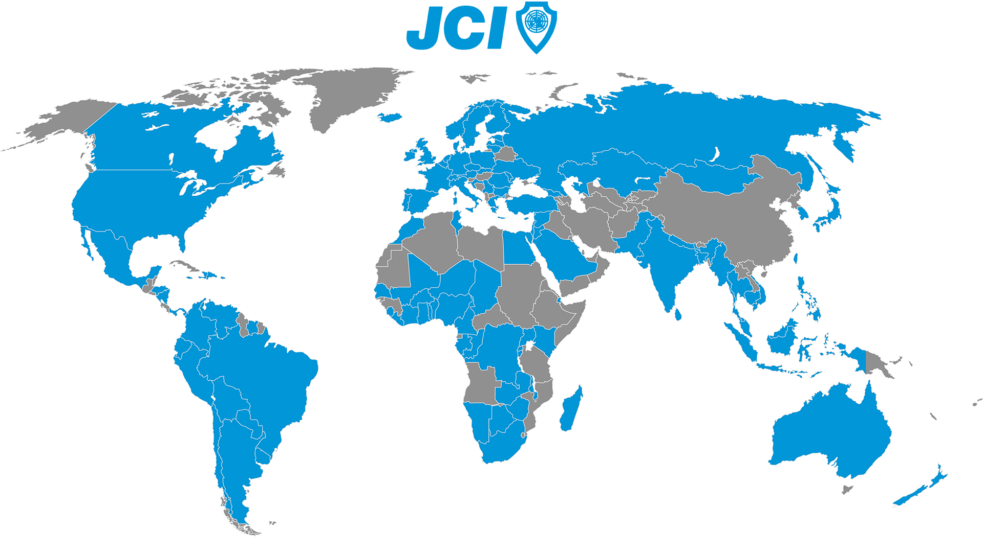
Everyday in over 100 countries
Notes:
As globally minded young people, we all have rights, responsibilities and share goals. We find targeted solutions to local issues benefitting our communities, our world and our future. Embracing new ideas, collaboration and diversity, we have the passion and courage to address the critical challenges of our time.

Slide 15

ACTIVE CITIZENSHIP

Slide 16

A GLOBAL PHENOMENON OF MEMBERSHIP ORGANIZATION
Notes:
The JCIM Sustainable Membership Framework (SMF) aims to provide Local Organizations with a clear perspective of membership challenges by understanding member needs, formulating membership development strategies, executing appropriate strategies and review the feedbacks from members.
Successful implementation of the SMF envisions to help promote the sustainability of JCI Malaysia Local Organizations.

Slide 17
TYPICAL SYMPTOMS REFLECTING
MEMBERSHIP CHALLENGES
Insufficient Membership Strength
Slow Growth of Membership
Lack of Members Participation in Events
Members Unmotivated in Organizing Events
Challenged LO Succession
Over Declared Membership Strength
Notes:
The JCIM Sustainable Membership Framework (SMF) aims to provide Local Organizations with a clear perspective of membership challenges by understanding member needs, formulating membership development strategies, executing appropriate strategies and review the feedbacks from members.
Successful implementation of the SMF envisions to help promote the sustainability of JCI Malaysia Local Organizations.

Slide 18

In an organization that deals with people….
… the success of the organization will be through its people…
Notes:
"Human capital management" (HCM^{[17]}) is sometimes used^{[by whom?]} synonymously with "HR", although "human capital" typically refers to a more narrow view of human resources; i.e., the knowledge the individuals embody and can contribute to an organization. Likewise, other terms sometimes used to describe the field include "organizational management", "manpower management", "talent management", "personnel management", and simply "people management".

Slide 19

AN IDEA OF A SUSTAINABLE SOLUTION
To provide a practical framework that helps formulate sustainable membership solutions to provide a healthy organizational growth
Notes:
What does this mean? If we find a member showing up less than four times a month, it may call for attention. However this is just statistics and a rule of thumb for us to know.

Slide 20

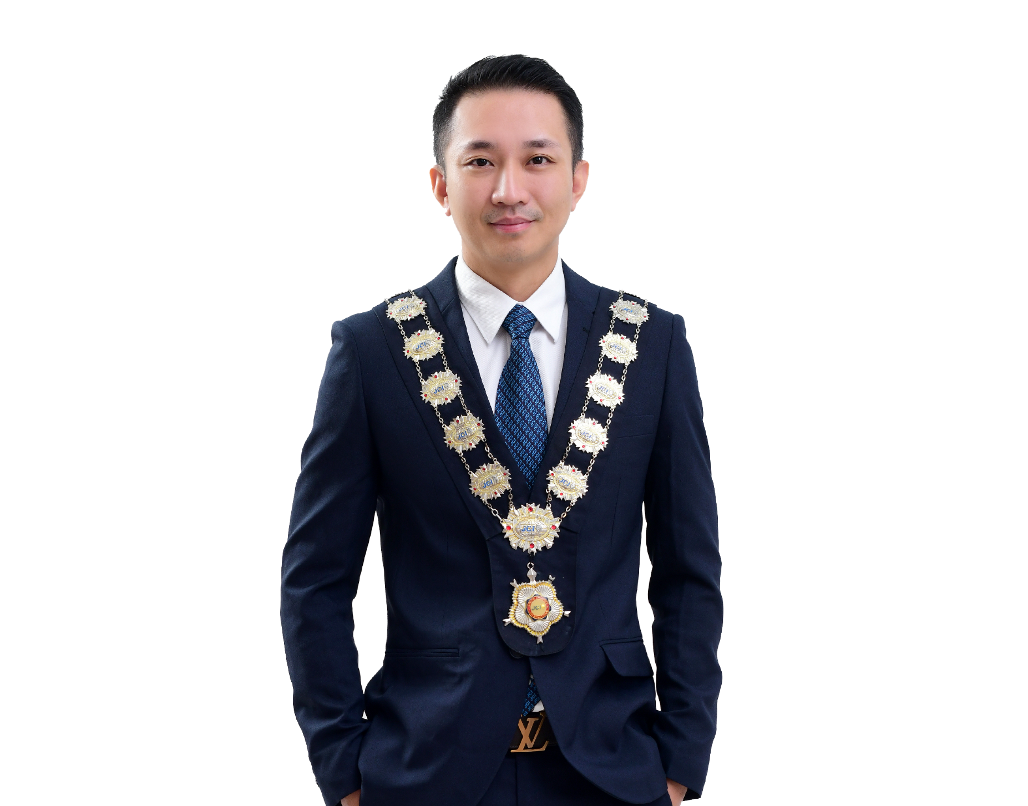
2019 JCI MALAYSIA
NEW INITIATIVE
SUSTAINABLE MEMBERSHIP FRAMEWORK
JCI SEN. ANDY LAU
2019 JCIM National President

Slide 21

SUSTAINABLE MEMBERSHIP FRAMEWORK

Slide 22
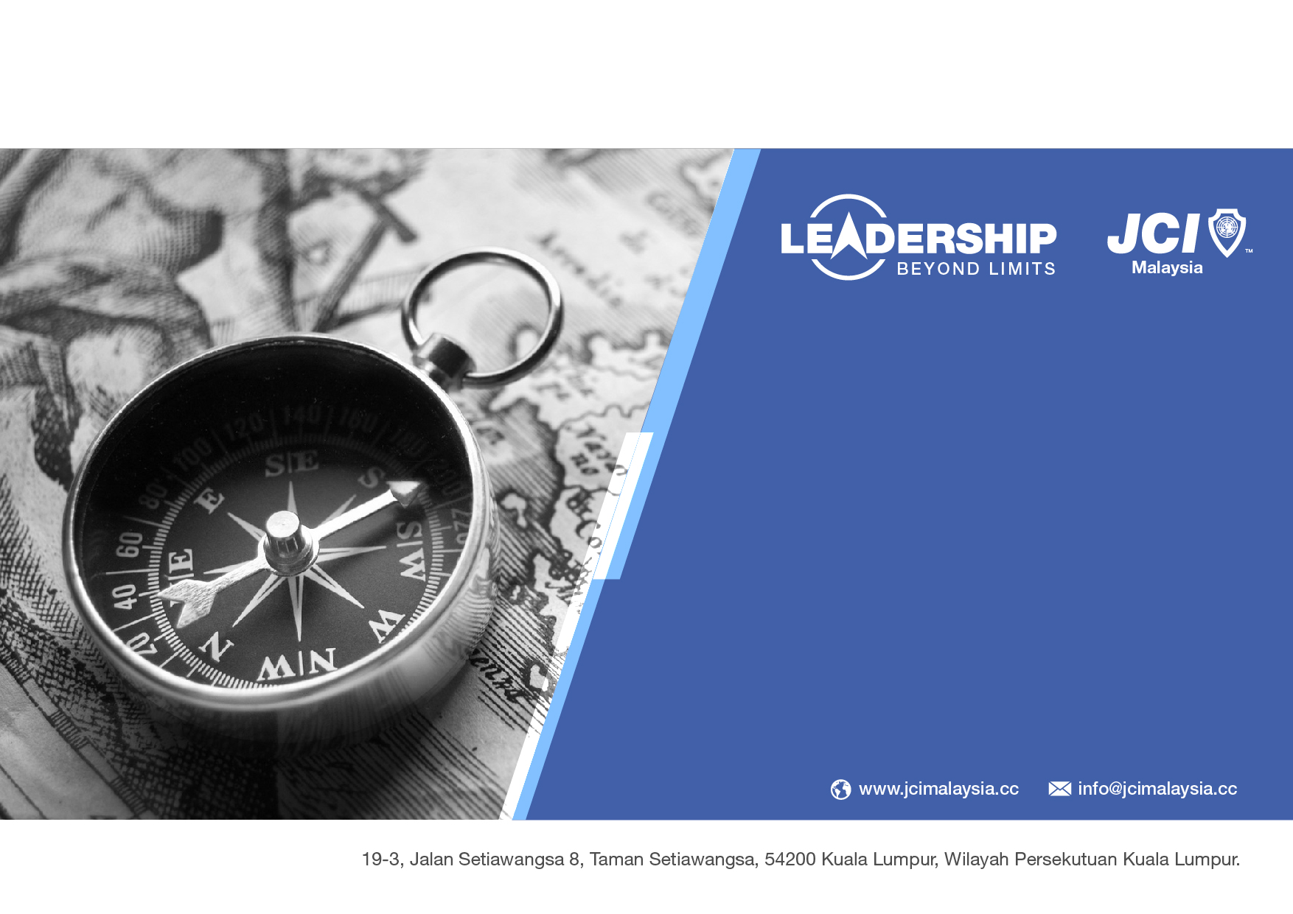
JCI Malaysia
Sustainable Membership Framework
2019 JCI Malaysia New Initiative
Notes:
The JCIM Sustainable Membership Framework (SMF) aims to provide Local Organizations with a clear perspective of membership challenges by understanding member needs, formulating membership development strategies, executing appropriate strategies and review the feedbacks from members.
Successful implementation of the SMF envisions to help promote the sustainability of JCI Malaysia Local Organizations.

Slide 23


SURVEY
A Process of Gathering Relevant
Membership Data
Notes:
According to analytics, the key number is less than 4. New members who spend less then 4 times a month in functions have an average retention rate of less than 58%. Members who spend more than 8-11 times have a retention rate of over 71%.
Membership Participation is one of the most important factor towards Membership Retention. How do we let members participate more actively?
Member Onboarding
According to Dr Bedford’s research, the single factor that impacts member retention so much it seems like magic!
Members orientation plus three follow-up appointments ensures member’s goal were clearly understood and they were given a plan to overcome barriers and achieving those goals.
Member Engagement
According to Dr Bedford’s research, the single factor that impacts member retention so much it seems like magic!
Members orientation plus three follow-up appointments ensures member’s goal were clearly understood and they were given a plan to overcome barriers and achieving those goals.

Slide 24

SURVEYING MEMBERSHIP DATA
Understanding Needs
JCI Members
Local Community
Notes:
Survey Members Needs
Deploy effective data acquisition methods to gather member information
JCI Members generally join the organization for a few main reasons but not limited to the following:
Personal Development
Leadership Development
Community Development/Service
Business Network Development/Expansion
International Outreach/Brotherhood

Slide 25

SURVEYING MEMBERSHIP DATA
Gather Data using:
Internal Survey that focuses on membership development
External Survey that focuses on partnership opportunities
Notes:
Survey Members Needs
Deploy effective data acquisition methods to gather member information
JCI Members generally join the organization for a few main reasons but not limited to the following:
Personal Development
Leadership Development
Community Development/Service
Business Network Development/Expansion
International Outreach/Brotherhood

Slide 26
ACTION PLAN FOR SURVEY
Internal
  Fill JCIM Membership Survey Form
  Conduct LO Members Dialogue
  Implement Member e-Attendance Form
External
  Dialogue with Government, Corporates and other NGOs
  Survey with Public Community through JCIM Open Days
Notes:
The following tools/steps can be used:
Internal Survey:
Membership Survey
Member Attendance Records
External Survey:
Dialogue with Government, Corporate and Other NGO (Dialogue Agenda)

Slide 27
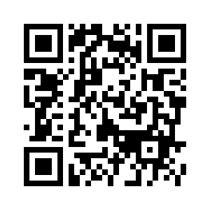
UNDERSTANDING YOUR ASSETS
JCIM Survey Form
Basic Information
Membership Information
Development Information
Notes:
Survey Members Needs
Deploy effective data acquisition methods to gather member information
JCI Members generally join the organization for a few main reasons but not limited to the following:
Personal Development
Leadership Development
Community Development/Service
Business Network Development/Expansion
International Outreach/Brotherhood

Slide 28

ANALYSE
A Process of Insightful and Systematic
Membership Data Analysis
Notes:
According to analytics, the key number is less than 4. New members who spend less then 4 times a month in functions have an average retention rate of less than 58%. Members who spend more than 8-11 times have a retention rate of over 71%.
Membership Participation is one of the most important factor towards Membership Retention. How do we let members participate more actively?
Member Onboarding
According to Dr Bedford’s research, the single factor that impacts member retention so much it seems like magic!
Members orientation plus three follow-up appointments ensures member’s goal were clearly understood and they were given a plan to overcome barriers and achieving those goals.
Member Engagement
According to Dr Bedford’s research, the single factor that impacts member retention so much it seems like magic!
Members orientation plus three follow-up appointments ensures member’s goal were clearly understood and they were given a plan to overcome barriers and achieving those goals.

Slide 29

ANALYSING MEMBERSHIP CHALLENGES
Insightful examination on data collected
SWOT study on LO membership status:
  Data collected will be table in the dialogue between BOD and LO SPC
Notes:
Upon acquiring the required and relevant data, it will allow local organization to identify and analyze their member’s needs and expectations.
We cannot solve membership challenges without first understanding their needs.

Slide 30
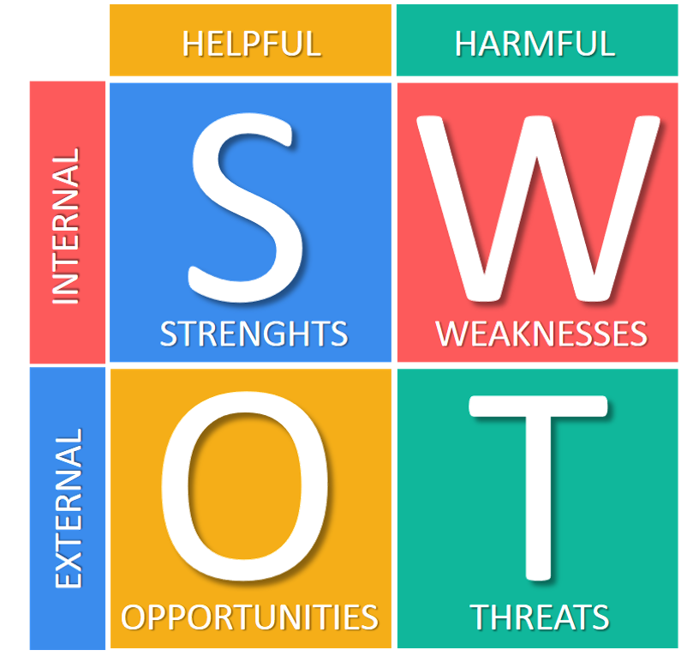
ACTIVITY: UNDERSTANDING YOUR ORGANIZATION
Discuss in your team：
List out your strengths, weaknesses, opportunities and threats of your organization.
(5 minutes)
Notes:
The following tools/steps can be used:
Set up a Membership Development Council
Incorporate Membership Development into LO Strategic Plan and LO Plan of Action, Calendar Activity
Conduct or Attend Active Citizen Workshop,
Conduct or Attend JCI Impact
Conduct or Attend Project Management
Conduct or Attend Officer Training Workshop
Developing Membership Programs that meets LO’s specific member needs is a crucial factor towards a strong membership strength.

Slide 31
KEY ASPECTS OF MEMBERSHIP LIFECYCLE
Membership Recruitment
Membership Onboarding
Membership Engagement
Notes:
The JCIM Sustainable Membership Framework (SMF) aims to provide Local Organizations with a clear perspective of membership challenges by understanding member needs, formulating membership development strategies, executing appropriate strategies and review the feedbacks from members.
Successful implementation of the SMF envisions to help promote the sustainability of JCI Malaysia Local Organizations.
12 Time-Tested Tips for Membership Recruitment, Engagement, and Retention
https://www.scottoserassociates.com/12-time-tested-tips-for-membership-recruitment-engagement-and-retention/

Slide 32

ACTION PLAN FOR “ANALYSING”
Utilizing Membership Analyzing Toolkits
Dialogue with Strategic Planning Committee
  [Sample Dialogue Agenda]
Member Lifecycle Strategy Workshop
  [Slides & Materials Available]
Notes:
The following tools/steps can be used:
Membership Analysis Toolkit
Dialogue with LO Strategic Planning Committee
Member Lifecycle Strategy Workshop

Slide 33

PLANNING
A Process of Formulating and Planning Sustainable
Membership Strategies and Programs
Notes:
According to analytics, the key number is less than 4. New members who spend less then 4 times a month in functions have an average retention rate of less than 58%. Members who spend more than 8-11 times have a retention rate of over 71%.
Membership Participation is one of the most important factor towards Membership Retention. How do we let members participate more actively?
Member Onboarding
According to Dr Bedford’s research, the single factor that impacts member retention so much it seems like magic!
Members orientation plus three follow-up appointments ensures member’s goal were clearly understood and they were given a plan to overcome barriers and achieving those goals.
Member Engagement
According to Dr Bedford’s research, the single factor that impacts member retention so much it seems like magic!
Members orientation plus three follow-up appointments ensures member’s goal were clearly understood and they were given a plan to overcome barriers and achieving those goals.

Slide 34

THE JCI IDENTITY – POSITIONING & BRANDING
Notes:
Positioning is the process of positioning our brand in the market.
Branding is the way the community and members perceive you.

Slide 35
NOTABLE JCI IDENTITIES
YOUTH WITH A PURPOSE
CAR BOOT BARTER TRADE
SMILE FOR PEACE
TREASURE HUNT
LOVE EARTH DAY
PHUA CHU KANG ACTION
BUDDY NOT BULLY
BACK TO SCHOOL
Notes:
Positioning is the process of positioning our brand in the market.
Branding is the way the community and members perceive you.

Slide 36

Notes:
The following tools/steps can be used:
Set up a Membership Development Council
Incorporate Membership Development into LO Strategic Plan and LO Plan of Action, Calendar Activity
Conduct or Attend Active Citizen Workshop,
Conduct or Attend JCI Impact
Conduct or Attend Project Management
Conduct or Attend Officer Training Workshop
Developing Membership Programs that meets LO’s specific member needs is a crucial factor towards a strong membership strength.

Slide 37

PLANNING MEMBERSHIP PROGRAMS
Formulate Membership Strategies and Programs
Externally
Internally
    Formulate sustainable solution project using ACF strategy
    Encourage members involvement and engagement by understanding their needs
Notes:
Formulate Sustainable Solutions:
Depending on member’s need for every LO, BOD can develop specific strategies to meet member’s development needs.
Plan membership programs together with JCI members to give ownership and encourage member commitment and participation.

Slide 38


ACTION PLAN FOR “PLANNING”
Project Brainstorming
Project Planning
ACF Workshop
Regular Alignment with Strategic Planning Committee
Important Factors:
LO Branding and Positioning
Advancing Global Goals
Development Opportunity
Sustainable Impact
Notes:
The following tools/steps can be used:
Set up a Membership Development Council
Incorporate Membership Development into LO Strategic Plan and LO Plan of Action, Calendar Activity
Conduct or Attend Active Citizen Workshop,
Conduct or Attend JCI Impact
Conduct or Attend Project Management
Conduct or Attend Officer Training Workshop
Developing Membership Programs that meets LO’s specific member needs is a crucial factor towards a strong membership strength.

Slide 39
ACTIVITY: PLANNING YOUR IMPACT
Discuss in your team：
What projects can your organization do to be an important asset to our community? (5 mins)
Notes:
The following tools/steps can be used:
Set up a Membership Development Council
Incorporate Membership Development into LO Strategic Plan and LO Plan of Action, Calendar Activity
Conduct or Attend Active Citizen Workshop,
Conduct or Attend JCI Impact
Conduct or Attend Project Management
Conduct or Attend Officer Training Workshop
Developing Membership Programs that meets LO’s specific member needs is a crucial factor towards a strong membership strength.

Slide 40

ACTION
A Process of Implementing and Executing
Impactful Membership Development Projects
Notes:
According to analytics, the key number is less than 4. New members who spend less then 4 times a month in functions have an average retention rate of less than 58%. Members who spend more than 8-11 times have a retention rate of over 71%.
Membership Participation is one of the most important factor towards Membership Retention. How do we let members participate more actively?
Member Onboarding
According to Dr Bedford’s research, the single factor that impacts member retention so much it seems like magic!
Members orientation plus three follow-up appointments ensures member’s goal were clearly understood and they were given a plan to overcome barriers and achieving those goals.
Member Engagement
According to Dr Bedford’s research, the single factor that impacts member retention so much it seems like magic!
Members orientation plus three follow-up appointments ensures member’s goal were clearly understood and they were given a plan to overcome barriers and achieving those goals.

Slide 41
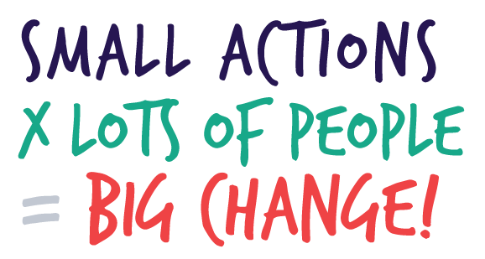
ACTION ON STRATEGIES AND PROJECTS
Engagement and involvement
  Run impactful LO project based on member’s development needs
Notes:
Take Action for Membership Development
The right Membership Development strategy and project can increase member engagement and participation.
The goal is to run projects/programs/initiatives that will promote a member’s active participation and meet the member’s needs.

Slide 42
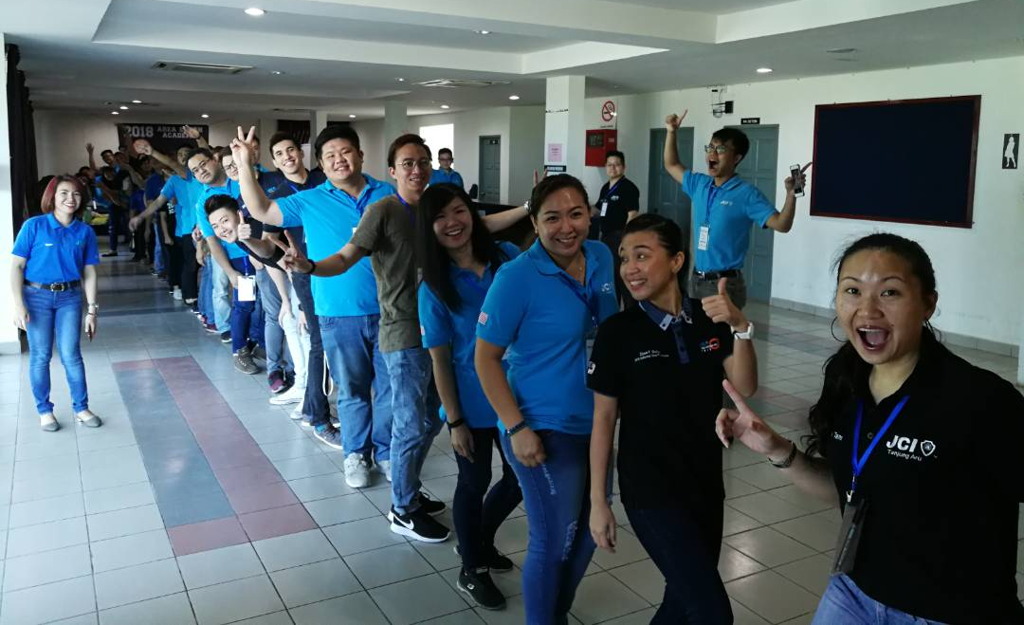
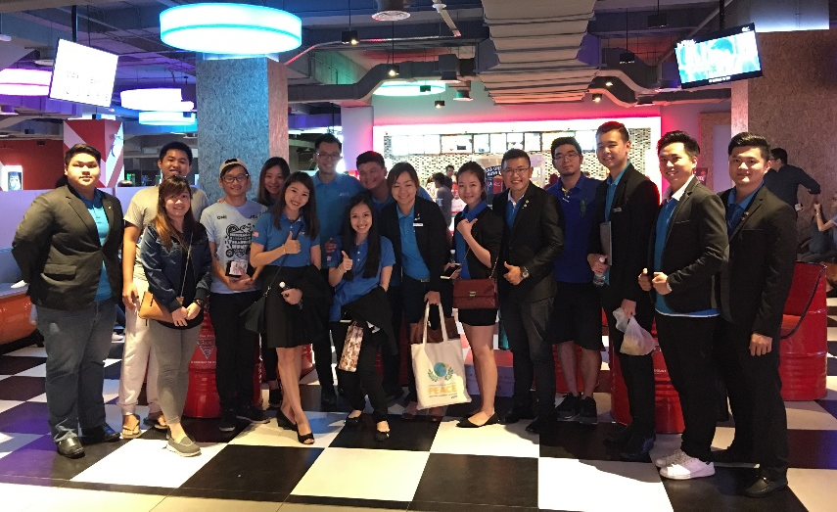
SUGGESTED PROGRAMS & PROJECTS
1+1+1 R&R System
ACF Project
Member Attendance Form
JCI Career Workshop
JCI Official Course
JCI Recommended Course
JCI Discovery
LO Flagship Project
Local Officer Academy
Project Management
Notes:
The following tools/steps can be used:
New Member Orientation
1+1+1 R&R System
Run Active Citizen Framework Projects
Members Attendance Tracking Form
100% Efficiency Members Award
JCI Career Planning Workshop in New Member Orientation
Distribute JCI Member Roles and Responsibility in New Member Orientation

Slide 43

THE MAGIC NUMBER
According to analytics, the key number is less than 4.
New members who spend less then 4 times a month in functions have an average retention rate of less than 58%.
Members who spend more than 8-11 times have a retention rate of over 71%.
Notes:
What does this mean? If we find a member showing up less than four times a month, it may call for attention. However this is just statistics and a rule of thumb for us to know.

Slide 44

EVALUATION
A Process of Evaluating and Reviewing
Membership Development Impacts and Results
Notes:
According to analytics, the key number is less than 4. New members who spend less then 4 times a month in functions have an average retention rate of less than 58%. Members who spend more than 8-11 times have a retention rate of over 71%.
Membership Participation is one of the most important factor towards Membership Retention. How do we let members participate more actively?
Member Onboarding
According to Dr Bedford’s research, the single factor that impacts member retention so much it seems like magic!
Members orientation plus three follow-up appointments ensures member’s goal were clearly understood and they were given a plan to overcome barriers and achieving those goals.
Member Engagement
According to Dr Bedford’s research, the single factor that impacts member retention so much it seems like magic!
Members orientation plus three follow-up appointments ensures member’s goal were clearly understood and they were given a plan to overcome barriers and achieving those goals.

Slide 45

EVALUATING MEMBERSHIP IMPACTS
Monitor, review and evaluate results:
  Performance of strategies implemented
  Feedback from members
  Development impact of member
Notes:
Monitor and Evaluate Results
The sustainability of the organization is highly dependent on the feedback of its members.
Monitoring the performance of strategies implemented and evaluating its impact towards our members is crucial to an organization’s growth
Readily available feedback form allows members to freely express their concerns and give their suggestions towards development of the organization

Slide 46
MEASURABLE KEY PERFORMANCE INDEX
Baseline
2018 Declared Membership
Retention Rate
Current Membership Strength
Recruitment Rate
2019 New Members
Membership Growth
2019 Declared Membership
LO Growth
2019 New Affiliated LO
Run ACF Project
Fill Membership Survey Form
Be a 100% Efficiency Member
Fill Membership Feedback Form
Track Members Attendance
Attend New Member Orientation
Notes:
The following tools/steps can be used:
Require all members to fill feedback form
Membership Development Commission to provide toolkits to help Local Organization to analyze data

Slide 47
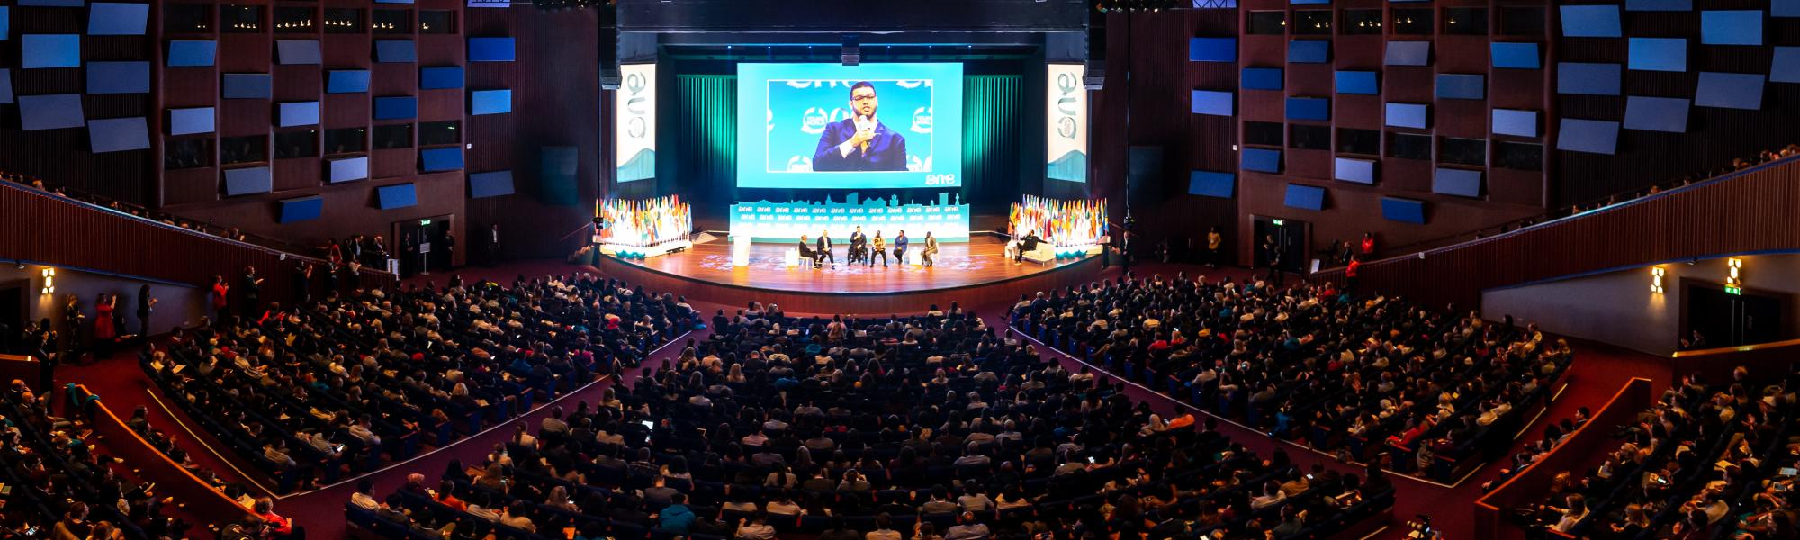
ACTION PLAN FOR “EVALUATION”
Fill JCIM Membership Feedback Form
Review by Membership Development Commission
Review by Strategic Planning Committee
Attend and Participate in JCIM Membership Forum
Notes:
The following tools/steps can be used:
Require all members to fill feedback form
Membership Development Commission to provide toolkits to help Local Organization to analyze data

Slide 48
JCIM SMF EXPECTED OUTCOME
More ACF projects that address community needs
More Young Active Citizens
Sustainable Local Organization Membership Strength
“Be the leading global network of young active citizens”
100% Efficiency Members
100% Efficiency Local Organizations
100% Efficiency National Organization
Notes:
The following tools/steps can be used:
Require all members to fill feedback form
Membership Development Commission to provide toolkits to help Local Organization to analyze data

Slide 49
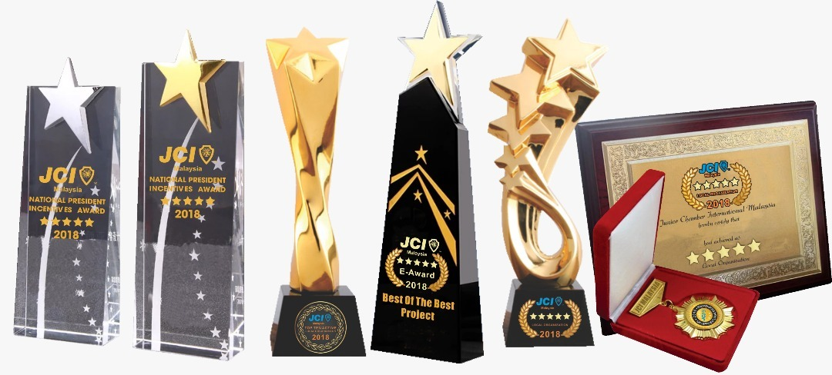
AN IMPACT-DRIVEN MODEL
EMPHASIZE on our projects
EMPHASIZE on our members
EMPHASIZE on our influence
EMPHASIZE on our impact
When we succeed to do these, we can’t help but be exceptionally OUTSTANDING!
Notes:
The following tools/steps can be used:
Require all members to fill feedback form
Membership Development Commission to provide toolkits to help Local Organization to analyze data

Slide 50

PARTNERSHIP
A Process of Identifying and Collaborating with
Internal and External Stakeholders for
Membership Development
Notes:
According to analytics, the key number is less than 4. New members who spend less then 4 times a month in functions have an average retention rate of less than 58%. Members who spend more than 8-11 times have a retention rate of over 71%.
Membership Participation is one of the most important factor towards Membership Retention. How do we let members participate more actively?
Member Onboarding
According to Dr Bedford’s research, the single factor that impacts member retention so much it seems like magic!
Members orientation plus three follow-up appointments ensures member’s goal were clearly understood and they were given a plan to overcome barriers and achieving those goals.
Member Engagement
According to Dr Bedford’s research, the single factor that impacts member retention so much it seems like magic!
Members orientation plus three follow-up appointments ensures member’s goal were clearly understood and they were given a plan to overcome barriers and achieving those goals.

Slide 51
PARTNERS IN MEMBERSHIP DEVELOPMENT
JCI MEMBERS
JCIM Membership Development Commission
JCIM Local Organization Strategic Planning Committee
Government, Civil Society, Public/Private Sectors
Public Community

Slide 52
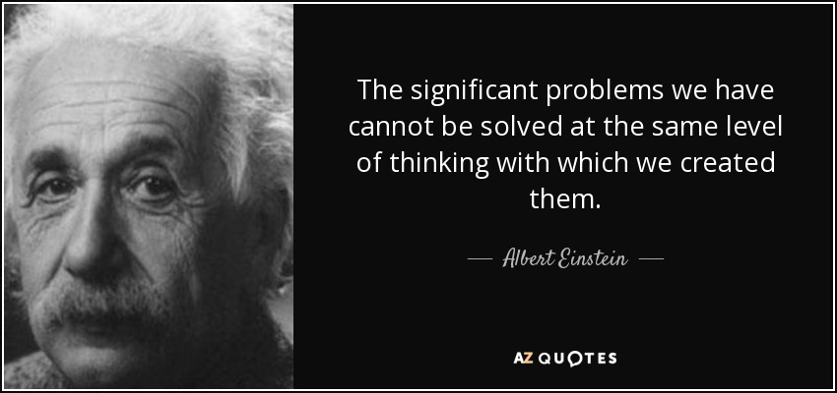
PARTNERSHIP GOALS & ADVANTAGES

Slide 53

JCI Malaysia
Membership Events
Standard Guidelines

Slide 54
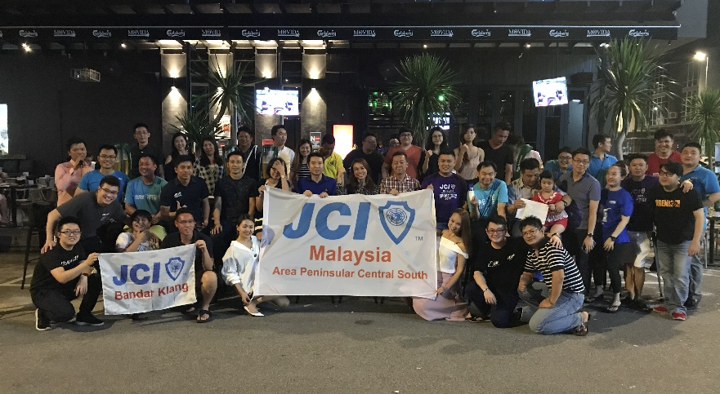
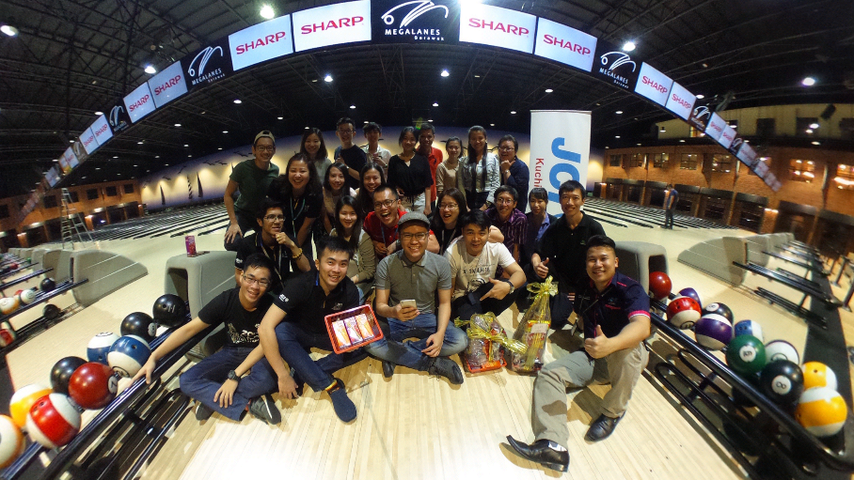
JCIM MEGA/SUPER GMM CUM
QUARTERLY PRESIDENT AWARDS
Introduction
A mega GMM can be used as a members recruitment tool for JCI friends to join a JCI event, have fun, meet new friends and even witness a quarterly award recognition.
Toolkits:
GMM Agenda Template
GMM Slides Template
Award Recognition Slide Template

Slide 55

JCIM OPEN DAY
Introduction
The open day is an event to create publicity of JCI and projects of LOs to the public to achieve specific objectives such as: member recruitment, project participation, community engagement etc.
Toolkits:
JCIM Open Day template
JCI Brochure template
JCIM Promotion Videos

Slide 56
JCI LOCAL ORGANIZATION BUNTING DESIGN
Introduction
The JCI LO Buntings can be strategically positioned at places to reach out to prospective members. It can showcase LO’s accomplishments as well as projects as a publicity tool.
Toolkits:
Standard bunting design
Bunting content template

Slide 57

“OPPORTUNITY TO IMPACT” VIDEO CONTEST
Introduction
The video contest is to spur the innovation of JCI members into creating impactful videos that portrays JCI Mission, Vision and Values in JCI ACF community driven projects.
Toolkits:
Contest rules & regulation
Contest marking criteria
Video editing software (free)

Slide 58

JCIM GRADUATION CEREMONY
Introduction
The JCIM Graduation Ceremony is to acknowledge the completion of a member’s JCI Journey after their 40th calendar Birth Year, to initiate local hall of fames for JCI members with significant contributions.
Toolkits:
JCI Career Achievement Slides template
JCI Certificate of Contribution/Completion
Ceremony Agenda Template

Slide 59
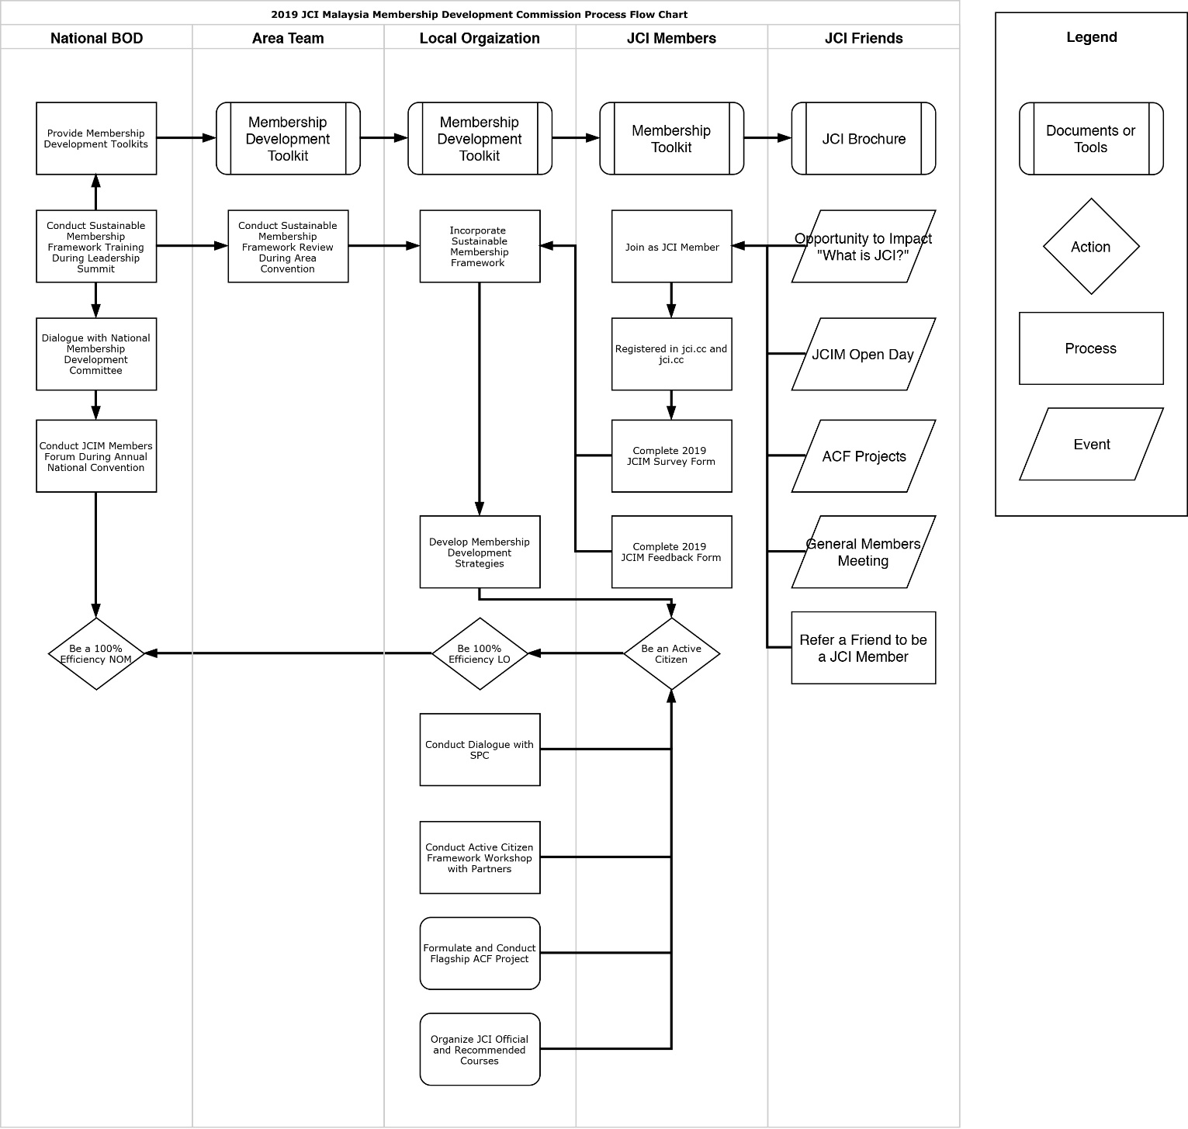
Notes:
The following tools/steps can be used:
Require all members to fill feedback form
Membership Development Commission to provide toolkits to help Local Organization to analyze data

Slide 60

CONCLUDING REMARKS
We hopes that the SMF can be utilized by all the local organizations within JCI Malaysia and create strong organizations that are able to continuously create sustainable impact that address community challenges while developing youths to be the leaders of tomorrow.
SMF will eventually, some day give references to other organizations in fulfilling our presidential theme of “Leadership Beyond Limits”

Slide 61

Thank you for your kind attention!
Wishing all a happy new year and an impactful and fruitful year ahead!

